Slide 1
DATA100
Principles of Data Science
Data Visualization
Notes:
Hi there! Unisse here! In this video, we’ll be talking about exploratory data analysis and the concepts needed for you to get started. (next)

Slide 2

Join at slido.com
#just-somethink

Slide 3
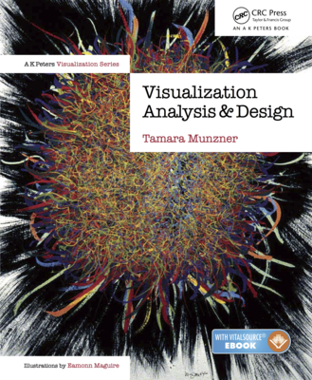
Reference Book
Tamara Munzner
Department of Computer Science
University of British Columbia
Follow her @tamaramunzner

Slide 4
Data Science Project Cycle
Recall
Problem
Start with a question that you want to answer or a problem you want to solve
Data
Maximize the potential of available data from various sources or collect your own
Explore
Understand the information embedded within the data
Learn
Use statistical models, machine learning and other data mining techniques to find patterns faster
Present
Effectively visualize and communicate the insights and knowledge derived from the data
Notes:
Now that we have some data, let’s work towards exploring and finding out what we were able to collect. (next)

Slide 5

Why do we visualize?
How hard has it been for you to make sense of your data without the use of graphs and charts?

Slide 6
Would you rather see this?
x | y
55.99303015 | 79.2772637
50.03225379 | 79.0130712
51.28845866 | 82.43593984
51.17053689 | 79.16529411
44.37791453 | 78.164628
45.01027007 | 77.88086312
48.55981672 | 78.7883706
42.14226829 | 76.88063455
41.02697157 | 76.40958846
34.57530901 | 72.72484118
x | y
31.16860072 | 69.24542132
32.64425407 | 70.73255503
26.66664565 | 62.98097121
26.45926233 | 62.63467337
25.53800765 | 60.63023611
26.32071119 | 62.39628112
26.16338746 | 62.0268149
25.21379046 | 60.2733986
26.85952956 | 63.14183467
31.76066917 | 69.79765539

Slide 7
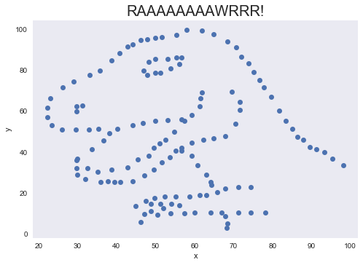
Or this?

Slide 8
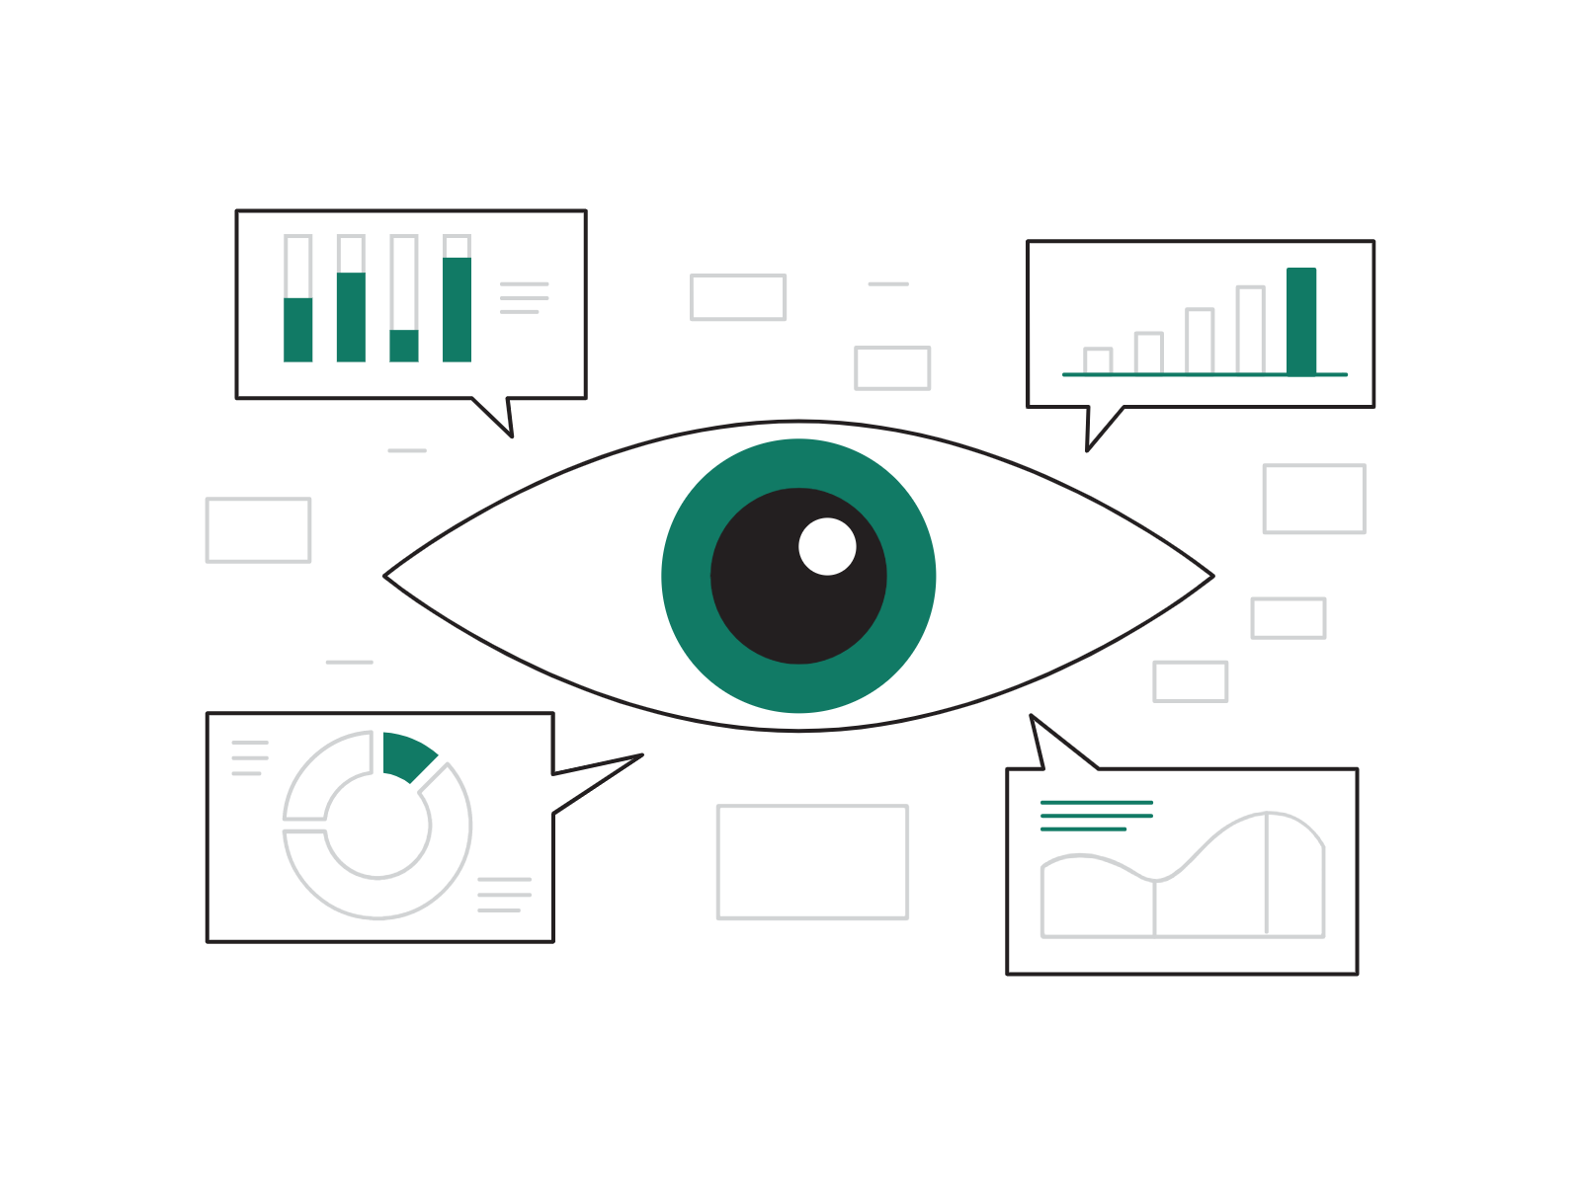
Visualizing data is not new!
It’s been present for a really long time already!

Slide 9

Figurative Map of the Successive Losses of Men of the French Army in the Russian Campaign (1812-1813)
Source: Reddit

Slide 10
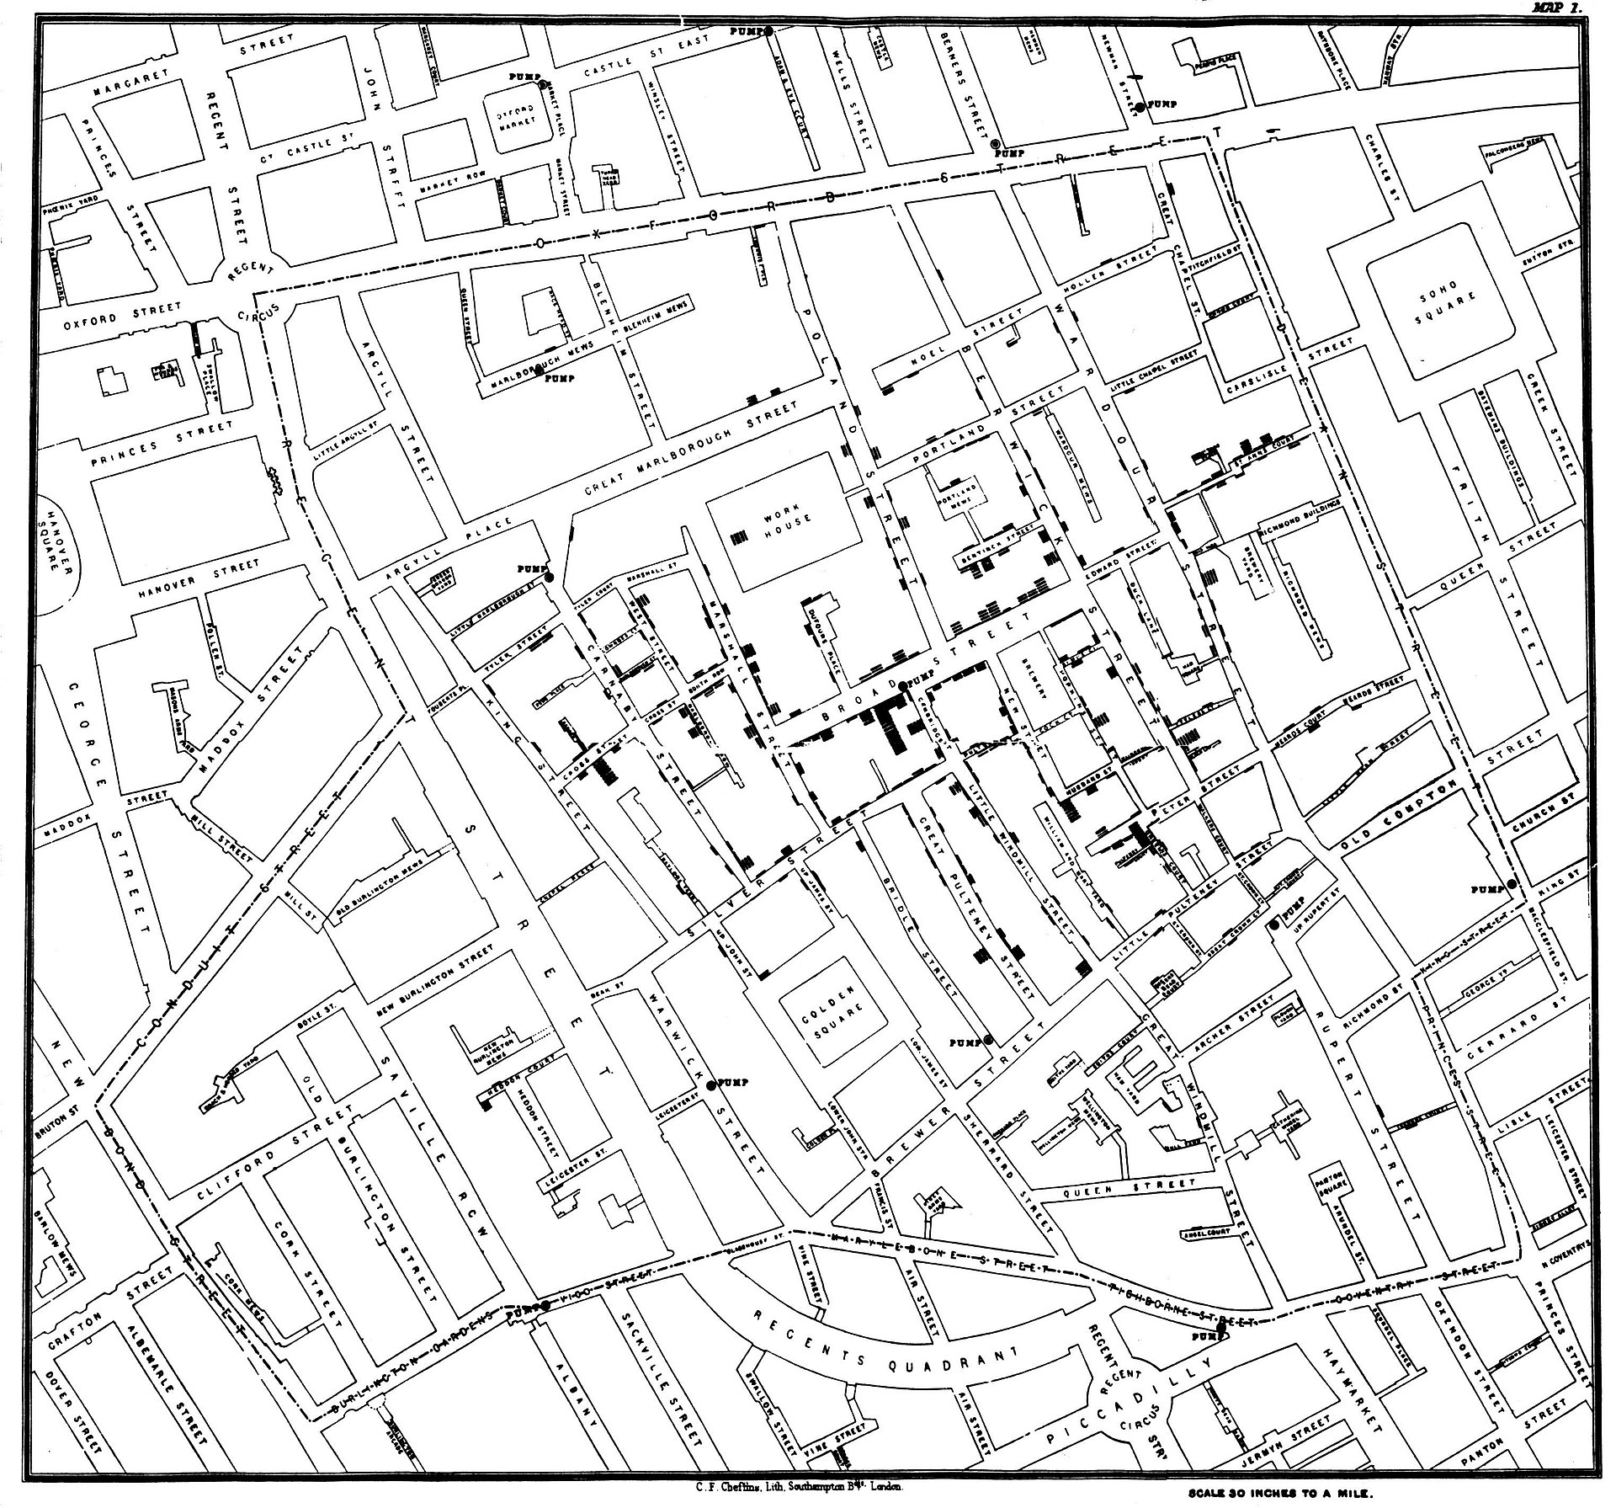
London Cholera Cases Map by John Snow (1854)
Source: John Snow

Slide 11
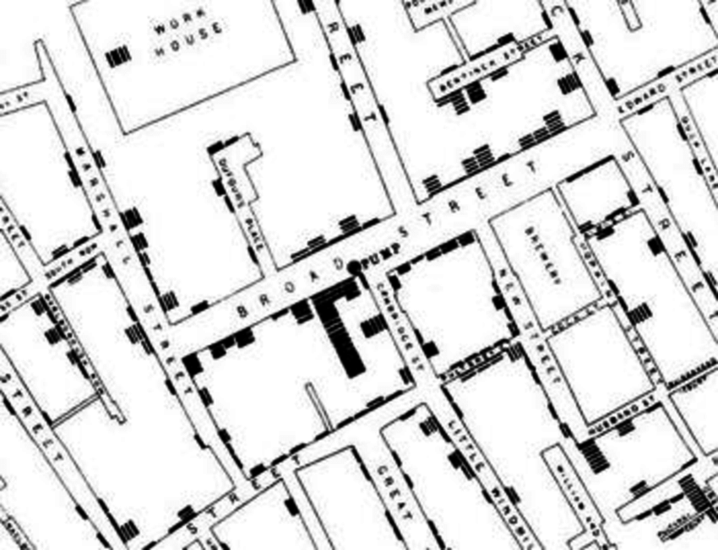
London Cholera Cases Map by John Snow (1854)
Source: John Snow

Slide 12
Why do we visualize?
What are the reasons why we visualize?

Slide 13
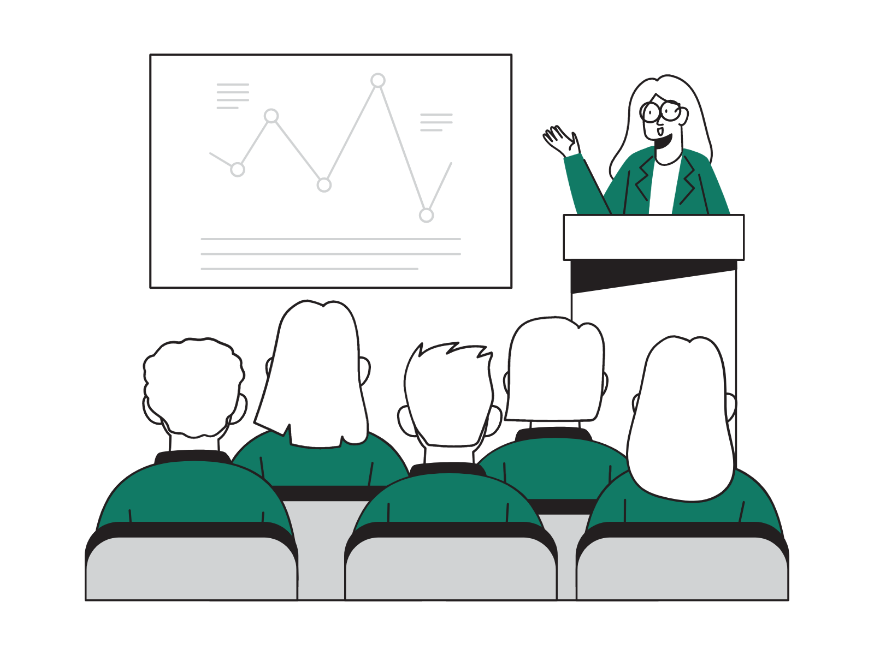

Communicate
Explore
Edward Tufte
Jer Thorp

Slide 14

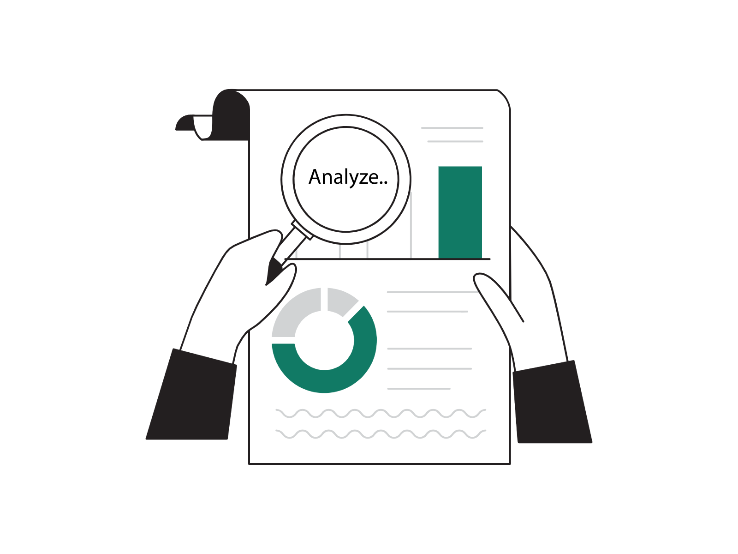


Visualization Goals
1
2
Analyze to support reasoning
Record information
4
3
Confirm hypothesis
Communicate ideas

Slide 15
Visualization Defined
Computer-based visualization systems provide visual representations of datasets designed to help people carry out tasks more effectively

Slide 16
Why have a human in the loop?
Computer-based visualization systems provide visual representations of datasets designed to help people carry out tasks more effectively
Visualization is suitable when there is a need to augment human capabilities rather than replace people with computational decision-making.

Slide 17
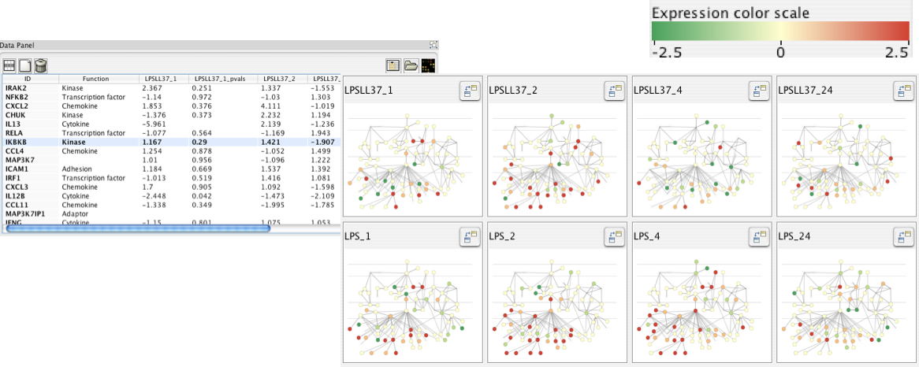
Why use external representation?
Computer-based visualization systems provide visual representations of datasets designed to help people carry out tasks more effectively
External representation offloads cognition and memory to perception.
[Cerebral: Visualizing Multiple Experimental Conditions on a Graph with Biological Context. Barsky, Munzner, Gardy, and Kincaid. IEEE TVCG (Proc. InfoVis) 14(6):1253-1260, 2008.]

Slide 18
Why rely on vision?
Computer-based visualization systems provide visual representations of datasets designed to help people carry out tasks more effectively
The human visual system is a high-bandwidth channel to the brain. Overview is possible due to background processing. There’s subjective experience of seeing everything simultaneously and significant processing occurs in parallel and pre-attentively.

Slide 19
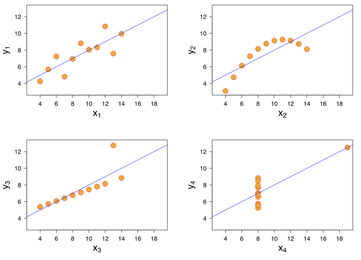
Why represent all data?
Computer-based visualization systems provide visual representations of datasets designed to help people carry out tasks more effectively
Anscombe’s Quartet
Property | Value
Mean of x | 9
Sample variance of x | 11
Mean of y | 7.50
Sample variance of y | 4.125
Correlation between x and y | 0.816
Linear regression line | y = 3.00 + 0.500x
https://www.youtube.com/watch?v=DbJyPELmhJc
Same stats, different graphs

Slide 20
How should we design visualizations?
Is there such a thing as a bad visualization?

Slide 21
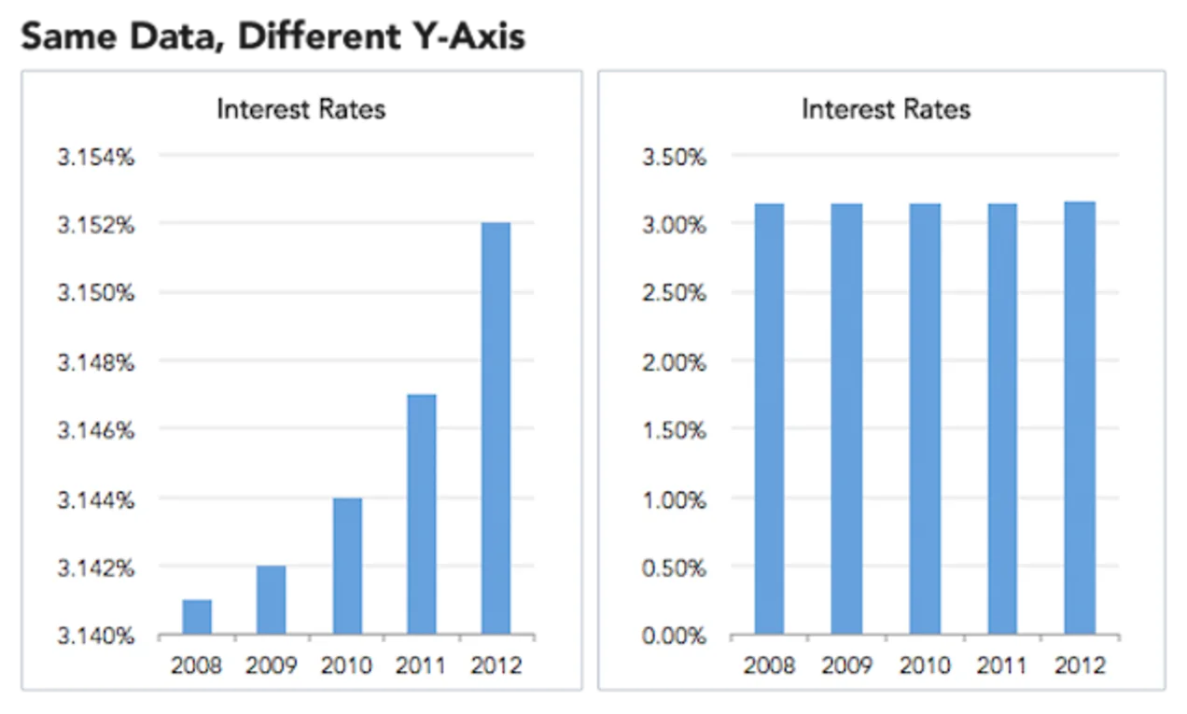
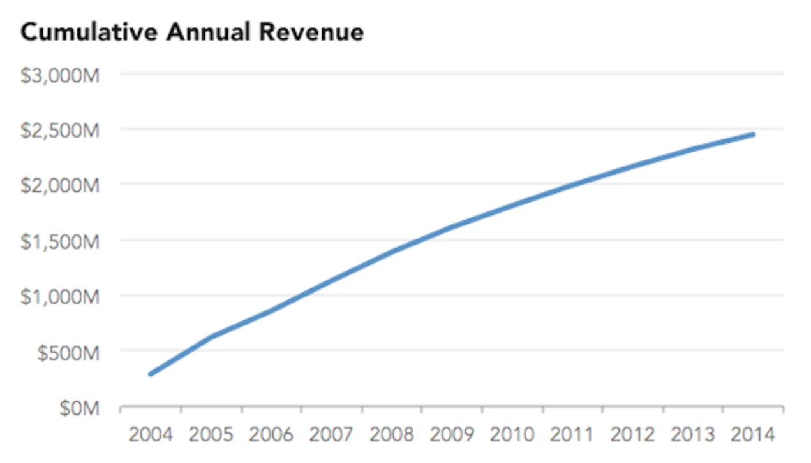
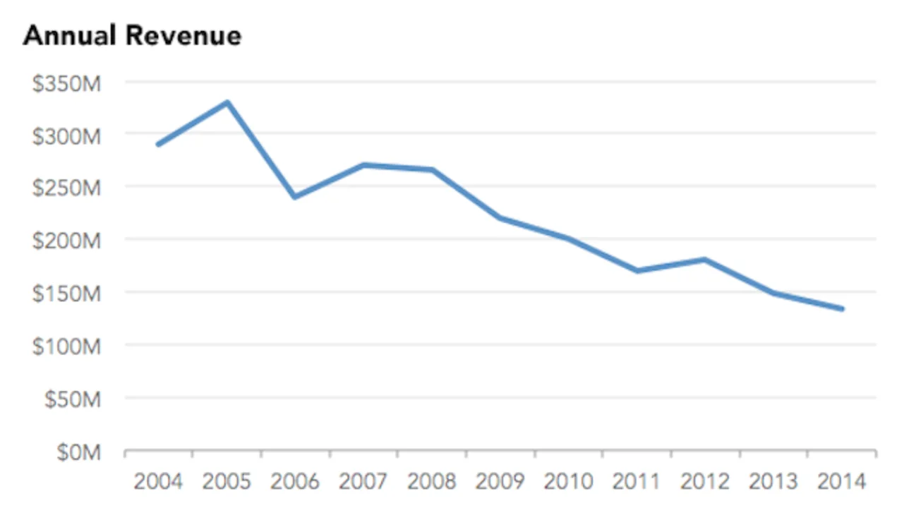
How to Lie with Data Visualization
Article in Gizmodo

Slide 22
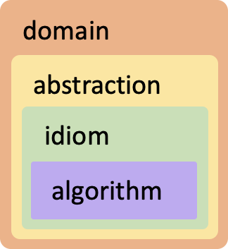
Four Levels of Visualization Design
[A Nested Model of Visualization Design and Validation. Munzner. IEEE TVCG 15(6):921-928, 2009
(Proc. InfoVis 2009). ]

Slide 23
Four Levels of Visualization Design
What?
Why?
How?
[A Nested Model of Visualization Design and Validation. Munzner. IEEE TVCG 15(6):921-928, 2009
(Proc. InfoVis 2009). ]

Slide 24
Four Levels of Visualization Design
Domain
Who are the target users?
Abstraction
Translate from specifics of domain to vocabulary of visualization
What is shown? Data abstraction
Why is the user looking at it? Task abstraction
Idiom
How is it shown?
Visual encoding idiom: how to draw
Interaction idiom: how to manipulate
Algorithm
Efficient computation

Slide 25
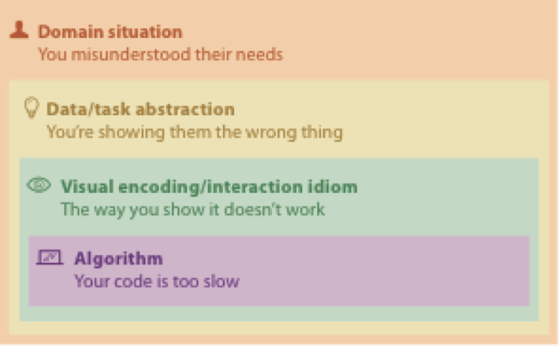
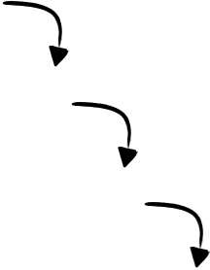
Different threats to validity at each level
Cascading effects downstream

Slide 26
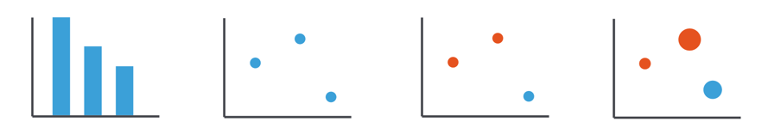
Visual Encoding

Slide 27
Visual Encoding
Lines
Points
Points with 2 colors
Points with 2 colors and different sizes

Slide 28

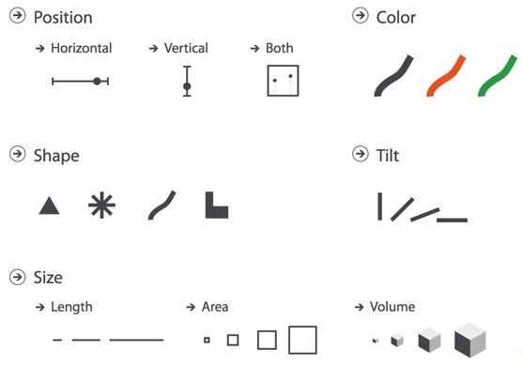
Marks and Channels
Marks (Data Points)
Geometric primitives
Channels (Features)
Control appearance of marks
Can appear with other channels

Slide 29
Data Categorization Overview
Variables
Qualitative
Quantitative
Categorical
Discrete/Continuous
Nominal
Ordinal
Interval
Ratio

Slide 30
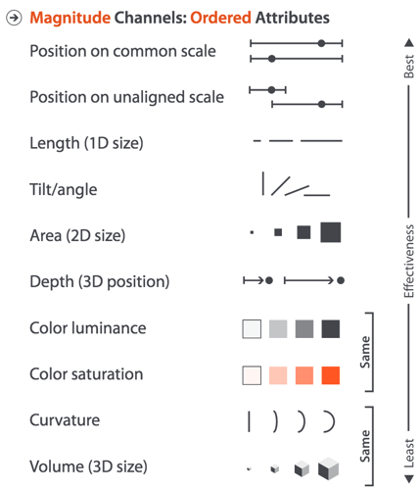
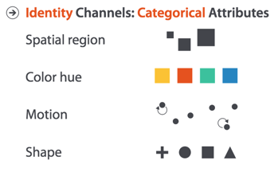
Channels: Matching Types
Expressiveness
Match channel to data type
Effectiveness
Encode most important attributes with highest ranked channel

Slide 31
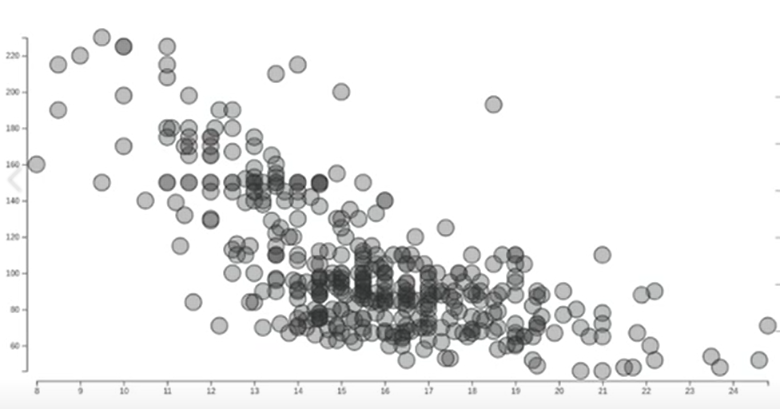
Identify the marks and channels used
Marks
Channels
Images captured from Kelleher C.

Slide 32
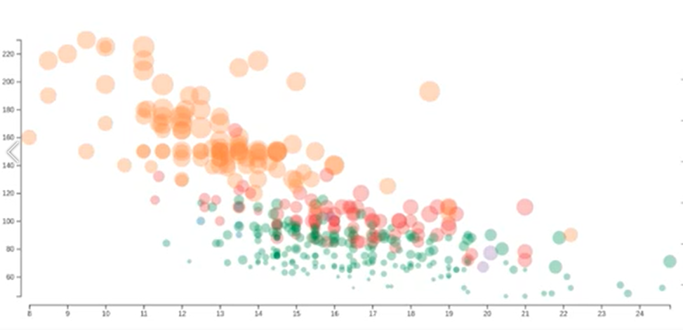
Identify the marks and channels used
Marks
Channels
Images captured from Kelleher C.

Slide 33
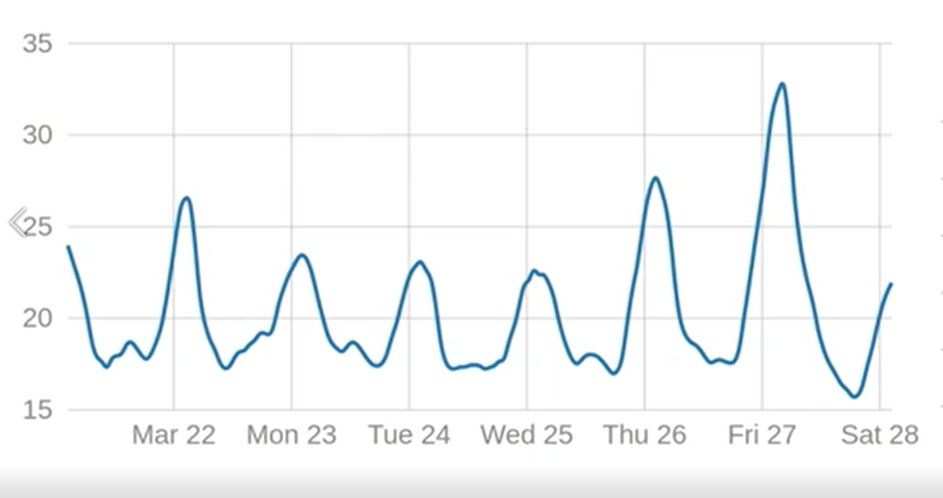
Identify the marks and channels used
Marks
Channels
Images captured from Kelleher C.

Slide 34
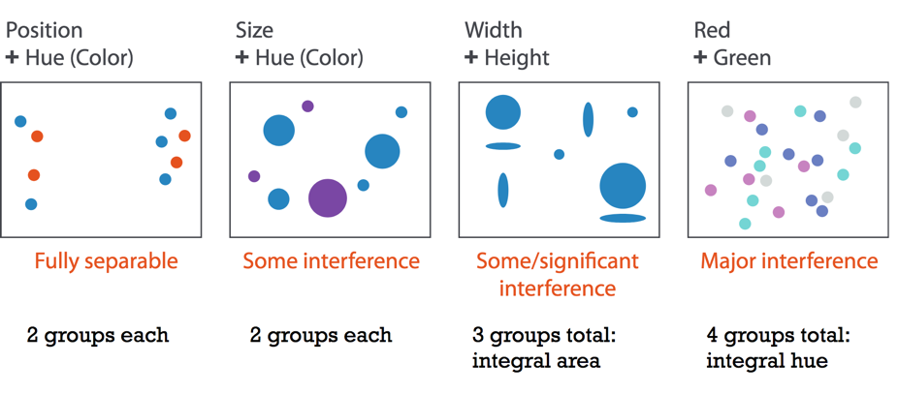
Make sure the data is still understandable!

Slide 35
Make sure the data is still understandable!

Slide 36
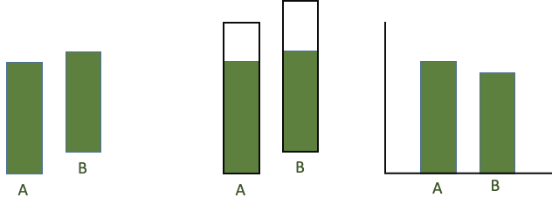
Which is bigger?

Slide 37
Which is bigger?

Slide 38
Which is bigger?

Slide 39
Which one was the easiest to differentiate?
1
2
3

Slide 40
Relative vs. Absolute Judgements
Perceptual system mostly operate with relative judgements, not absolute
Accuracy increases with common frame/scale & alignment
Weber’s Law: ratio of increment to background is constant
Filled rectangles differ in length by 1:9, difficult judgement
White rectangles differ in length by 1:2, easy judgement

Slide 41
Rules of Thumb (in designing)
No unjustified 3D
Power of the plane
Disparity of depth
Occlusion hides information
Perspective distortion dangers
Tilted text isn’t legible
No unjustified 2D
Eyes beat memory
Interactivity rules
Resolution over immersion
Overview first, zoom and filter, details on demand
Responsiveness is required
Function first, form next

Slide 42
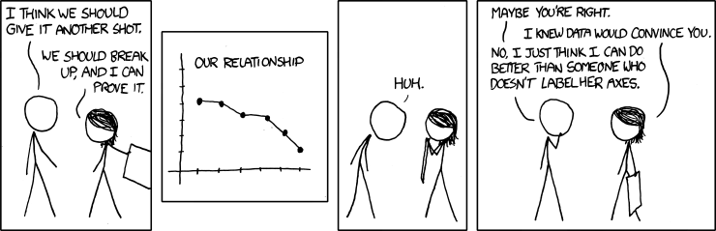
Label your charts!
Source: https://xkcd.com/833/

Slide 43
Label your charts!
Make visualizations self-documenting as possible
Meaningful & useful title, labels, legends
Axes should have labels and good min/max boundary tick marks
Everything plotted should have a legend
Own header/labels if not redundant with title
Use reasonable numerical format
Avoid scientific notations

Slide 44
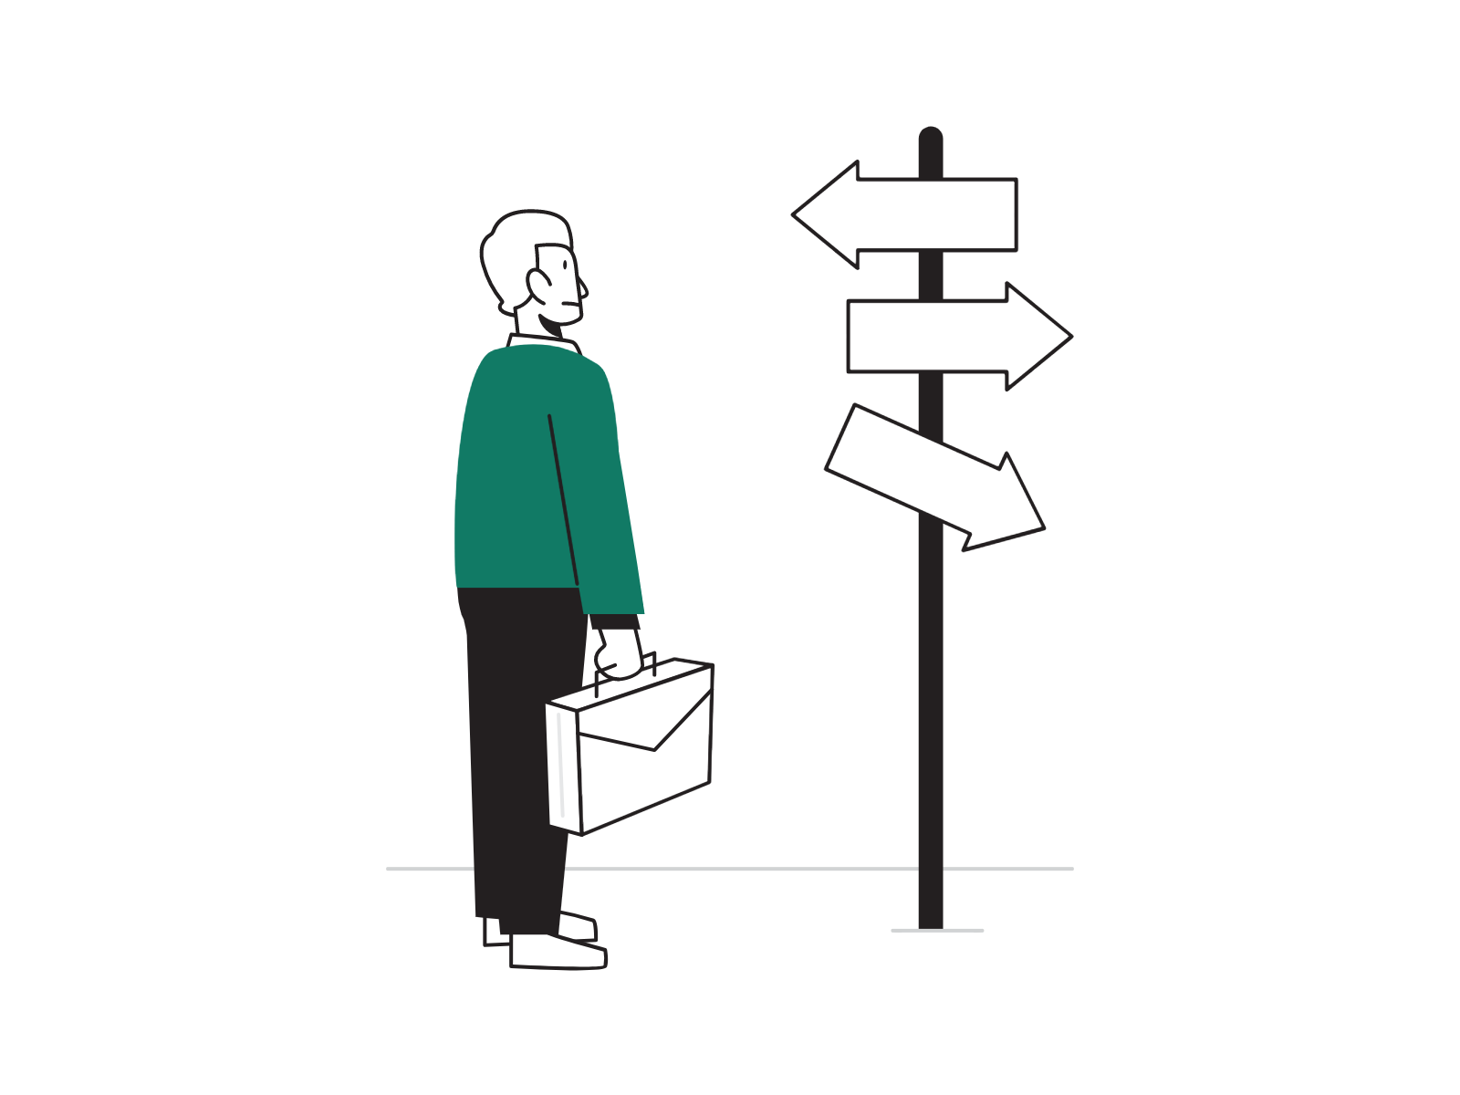
Choosing Colors
Colors matter!

Slide 45
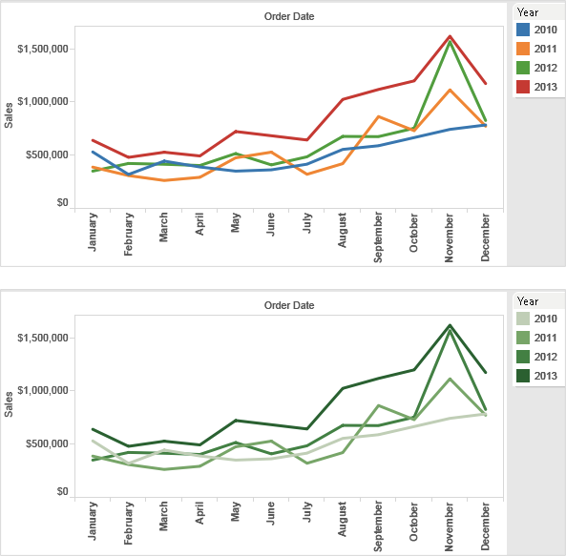
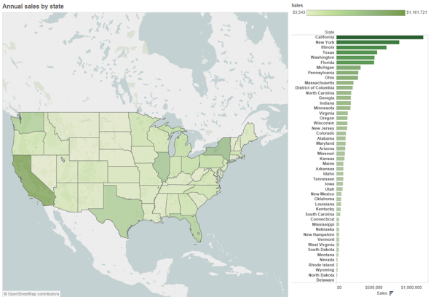
Categorical vs. ordered color
[Seriously Colorful: Advanced Color Principles & Practices. Stone.Tableau Customer Conference 2014.]

Slide 46
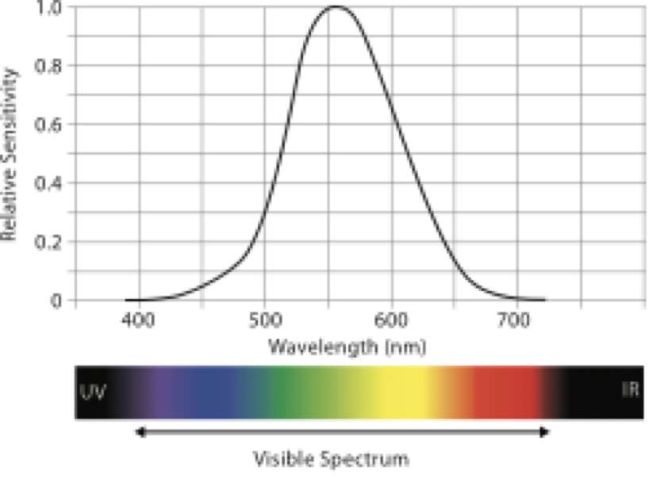
Spectral sensitivity

Slide 47
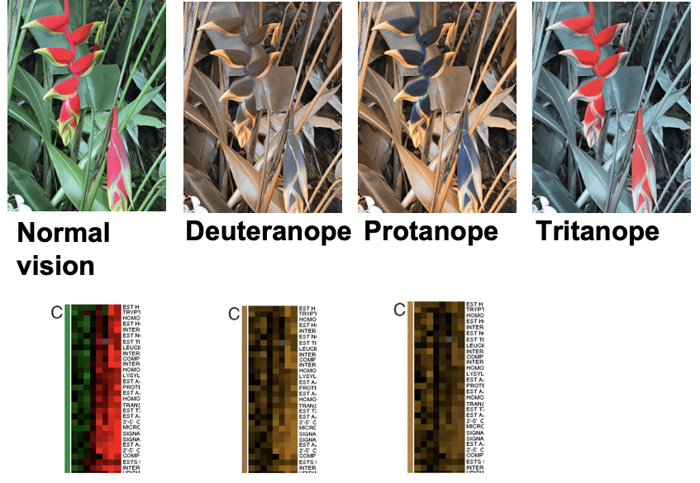
Designing for color deficiency:
Check with simulator
http://rehue.net
[Seriously Colorful: Color Principles & Practices. Stone.Tableau Customer Conference 2014.]

Slide 48
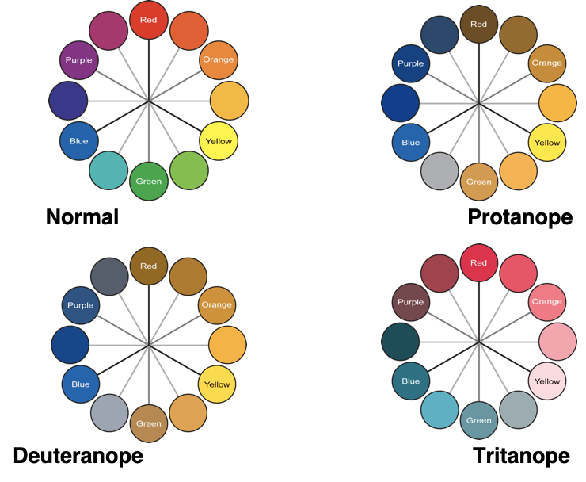
Color deficiency: Reduces color to 2 dimensions
[Seriously Colorful: Advanced Color Principles & Practices. Stone.Tableau Customer Conference 2014.]

Slide 49

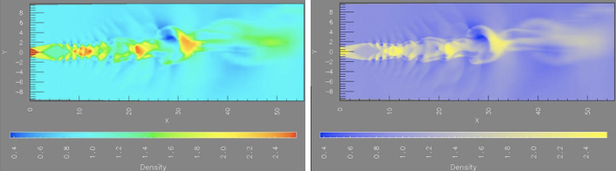
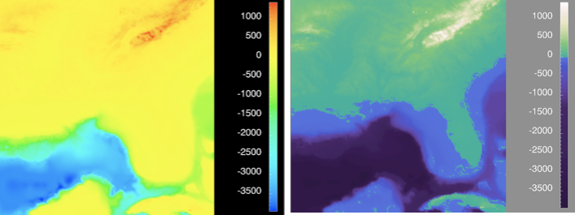
Ordered color: Rainbow is a poor default
Problems
Perceptually unordered
Perceptually nonlinear
Benefits
Fine-grained structure visible and nameable
Alternatives
Large-scale structure: fewer hues
Fine-structure: multiple hues with monotonically increasing luminance [e.g. viridis R/python]
[A Rule-based Tool for Assisting Colormap Selection. Bergman,. Rogowitz, and. Treinish. Proc. IEEE Visualization (Vis), pp. 118–125, 1995.]
[Why Should Engineers Be Worried About Color? Treinish and Rogowitz 1998. http://www.research.ibm.com/people/l/lloydt/color/color.HTM]
[Transfer Functions in Direct Volume Rendering: Design, Interface, Interaction. Kindlmann. SIGGRAPH 2002 Course Notes]

Slide 50
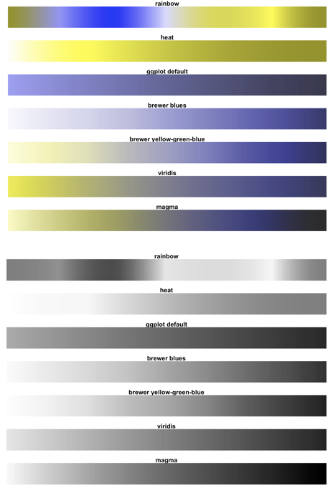
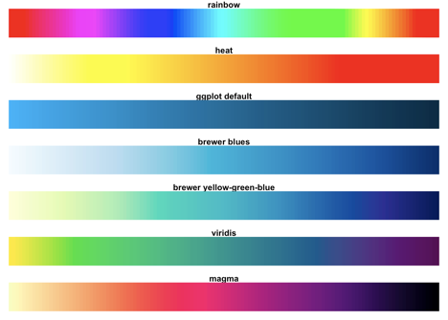
Viridis
Colorful, perceptually uniform, colorblind-safe, monotonically increasing luminance

